Slide 1
Japanese women in decision making
Hiroko Hashimoto,
Representative of Japan to CSW60
Professor Emeritus of Jumonji University

Slide 2
Longevity and Gender Gap Index
Source: http://reports.weforum.or/global-gender-gap-report-2015/
the longevity of Japanese women is the highest in the world, Japan’s ranking in the 2015 global gender gap index (GGI) is 101 out of 145 countries, which is the lowest among this event’s participating countries.
Table 1: Comparison of 2015 Global Gender Gap Index rankings

Slide 3
2030 Campaign
The Second National Action Plan to promote Gender Equality formulated in 2005 emphasized increasing the ratio of decision-making positions held by females to 30% by 2020.This is known as the “2030 Campaign”.

Slide 4
Law Regarding Promotion of Active Participation of Women in Their Working Life
the Law was adopted by parliament in August 2015 and will take effect on 1 April 2016.
Under the law, both private and public offices with more than 300 workers have to formulate publicize plans of action to promote gender equality, including the promotion of women in decision-making roles. Offices achieved better performances could be accredited and get advantage in public procurements.

Slide 5
1. The situation of women in decision making in Japan A) Women in politics
Table 2: Status of women in parliament
Country | Ranking in lower house female participation | Percentage of female members in lower house | Percentage of female members in upper house
Belgium | 18 | 39.30% | 50.00%
Italy | 42 | 31.00% | 28.30%
Bulgaria | 86 | 20.40% | -
Japan |  | 9.50% | 15.70%

Slide 6
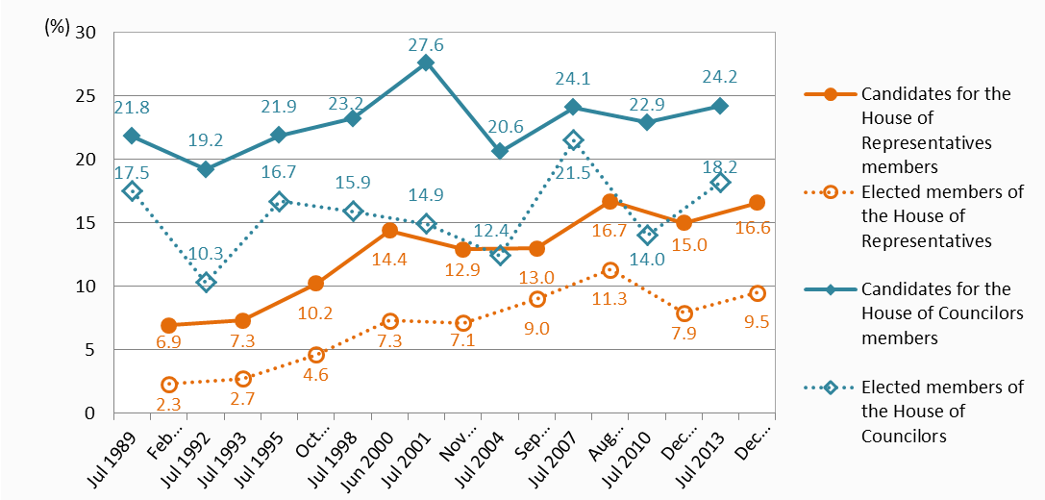
Female candidates and elected members of the House of Representatives in general elections and the House of Councilors in regular elections

Slide 7
Quota systems in four countries
 | legislated quotas |  |  |  | voluntary quota
 | Lower house | Upper house | sub-national |  | party
Belgium | ○ | ○ | ○ |  | X
Italy | X | X | ○ |  | ○
Bulgaria | no information avaiable in quota database
Japan | X | X | X | X

Slide 8
Movement to increase women in politics
In February 2015, the Multi-partisan Caucus for the Promotion of Women’s Active Political Participation was formed by parliamentarians of all major parties. The Caucus formulated a draft Law for the Promotion of Gender Equality in Politics which includes a voluntary quota system to be established by each political party.

Slide 9
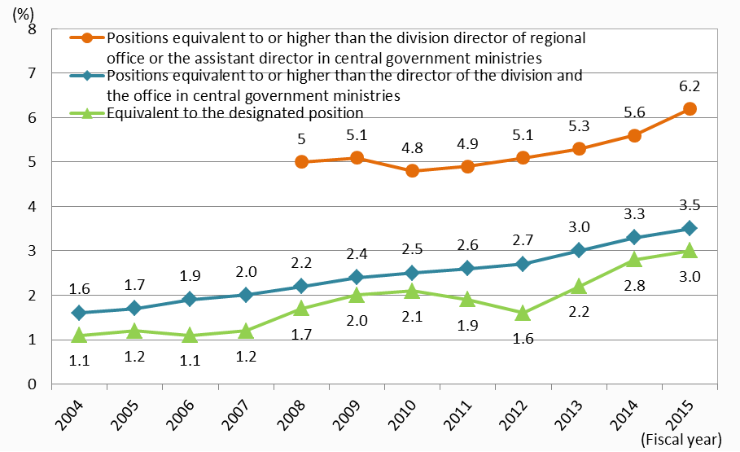
Female national employees in managerial positions

Slide 10
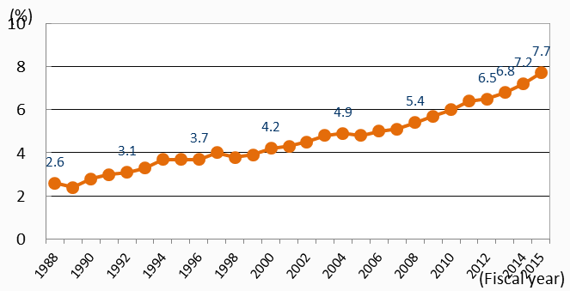
Female local public employees in managerial positions

Slide 11
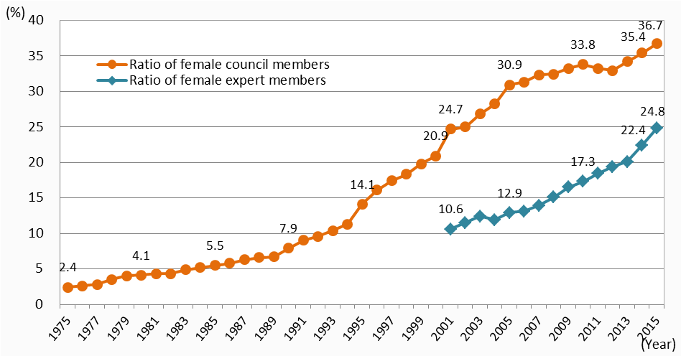
Women in national advisory councils

Slide 12
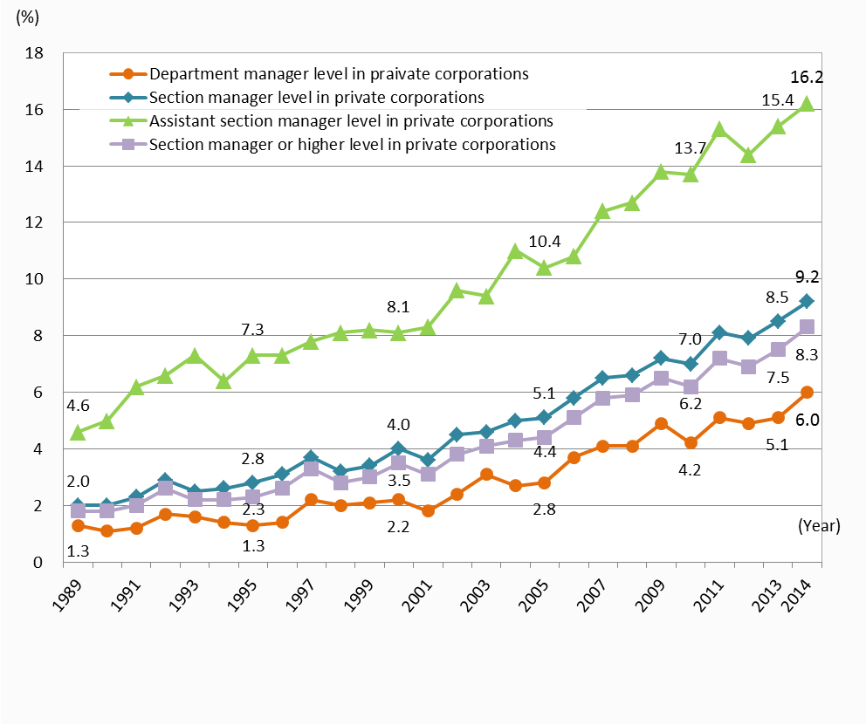
Women in private corporation managerial staff by position

Slide 13
How we can tackle this situation
The main barrier preventing Japanese women from becoming decision makers is the presence of strong social norms which consider women to be inappropriate as decision makers.
In a 2012 opinion poll on gender equality included a question on professions in which women’s participation should be increased.
Regarding the position of national parliament member, more than 50% of respondents said that more women should participate in greater numbers.

